Slide 1
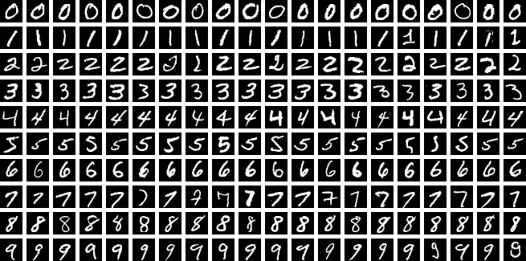
An Interactive Approach for Teaching Flow Matching
By Dylan, Hayley and Isaac

Slide 2
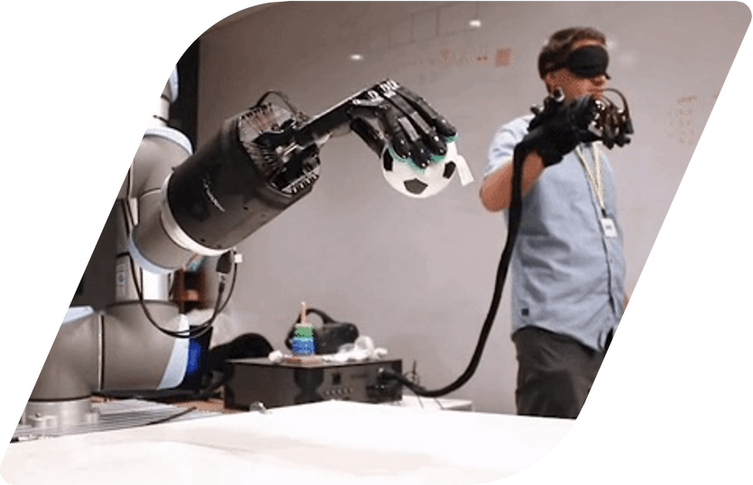

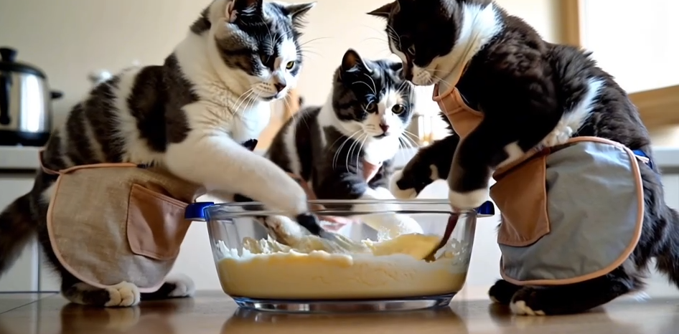
Motivation
Image Generation and Frame Prediction

Slide 3

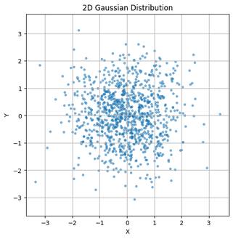

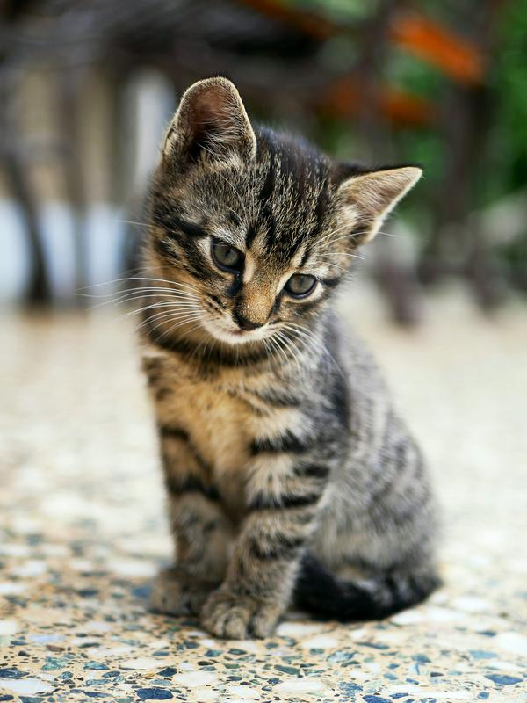
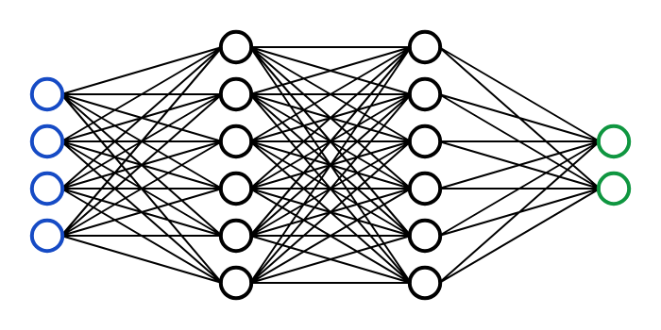
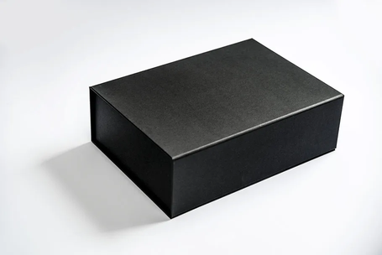
The Main Problem
Input
Trained
Model
Source: Victor Zhou – Neural Networks from Scratch – victorzhou.com
Flow Matching
Image
Dataset
A black box
(at least for now)
Output
Notes:
- flow matching generates another block box that produces black box
- given images
- learns vector field that pushes from gaussian to
- flow matching creates the model
- flow matching creates model >> expand on this
- add image that points to neural network/ml model >> output

Slide 4
Dataset – MNIST
The numbers dataset

Slide 5
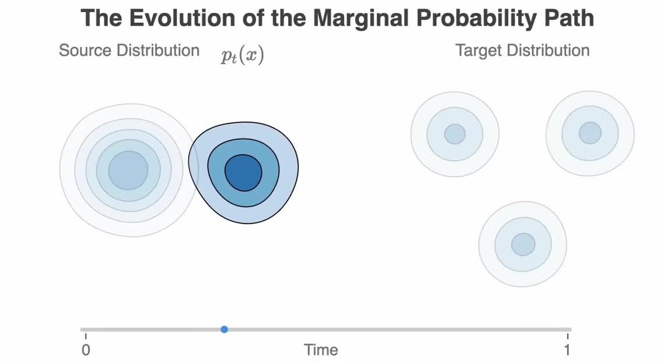

Slide 6
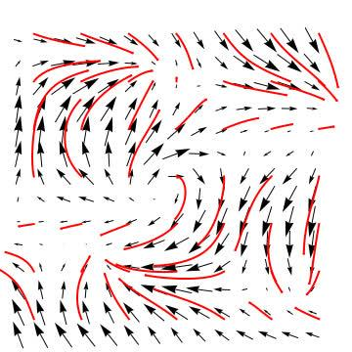
Vector Fields
A representation of vectors of each point in space
Notes:
vector field slowly move the points
kind of like pushing you in a direction
- flow matching trying to detect the wind
- try to predict ocean currents
- decide what wind where to go to a specifi direction

Slide 7
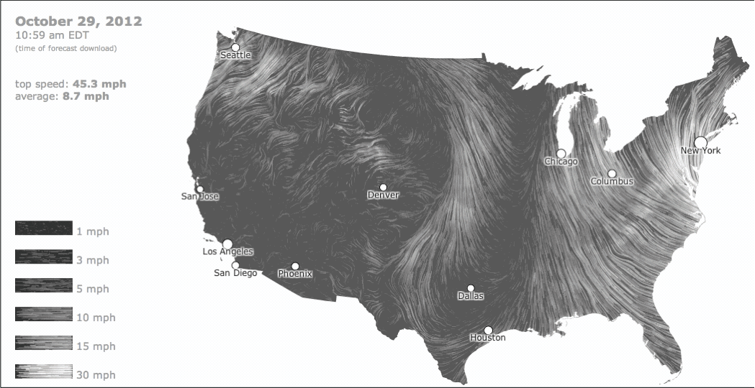
Vector Fields
A real word representation
Source: The Atlantic, Oct 29, 2012The Atlantic
Notes:
kind of like pushing you in a direction
- flow matching trying to detect the wind
- try to predict ocean currents
- decide what wind where to go to a specifi direction

Slide 8
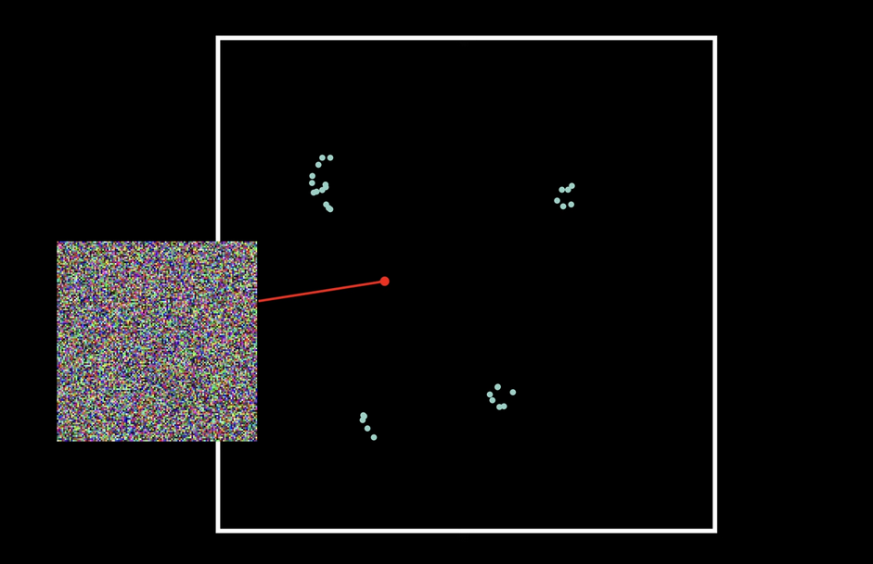

Slide 9
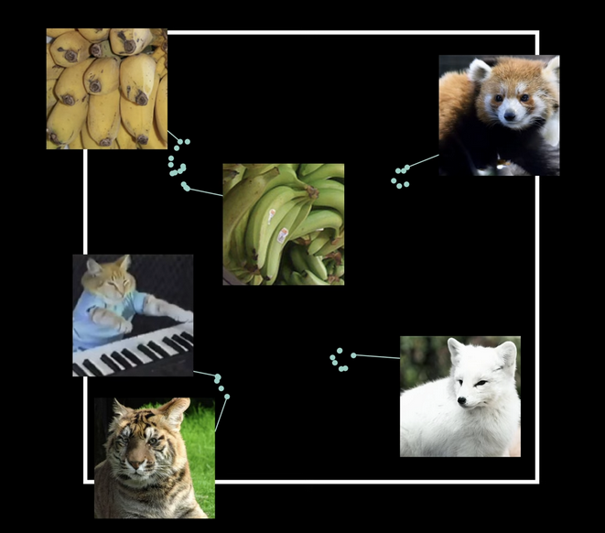

Slide 12


Slide 13
In reality...
Notes:
There are A LOT of possible 2D representations
It can be hard to visualize this for students

Slide 14
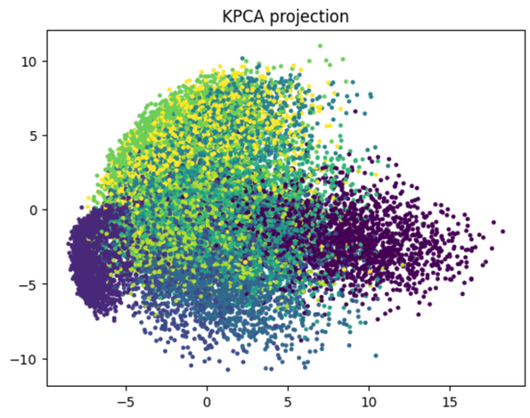
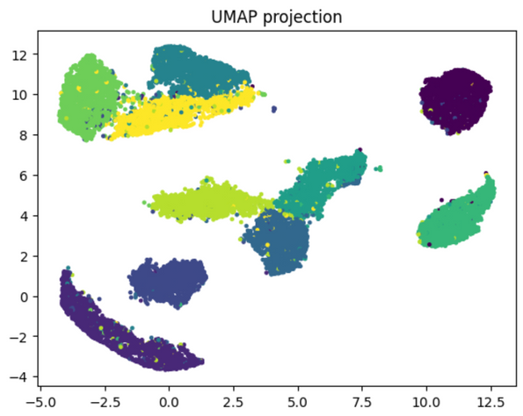
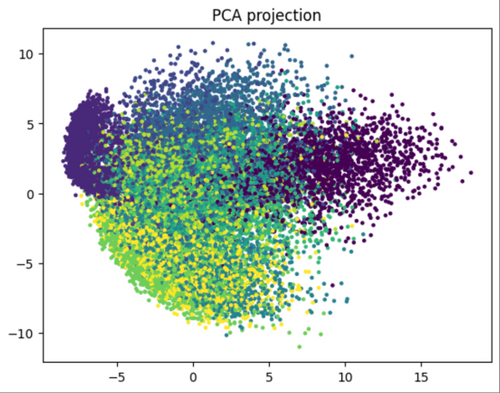
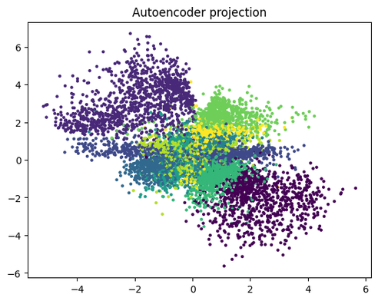
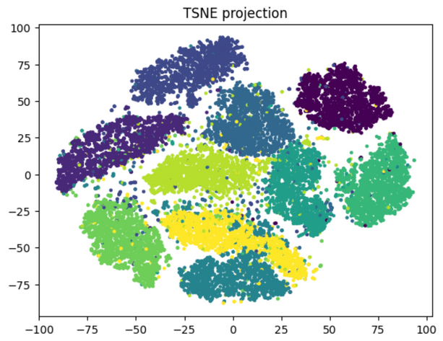
Latent Space Representations
Notes:
umap and tsne are non-deterministic

Slide 15
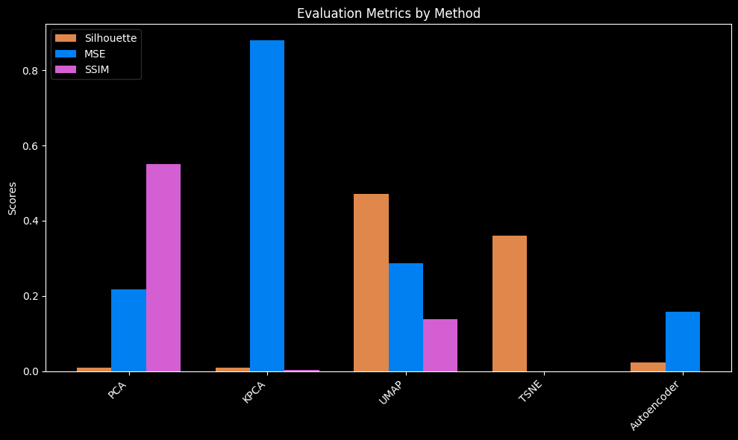
Comparing Approaches

Slide 16
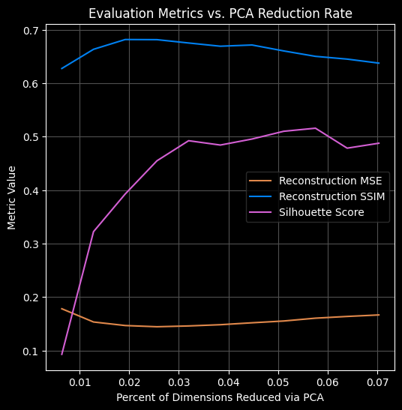
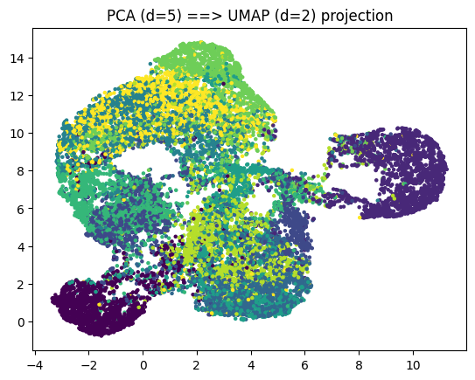
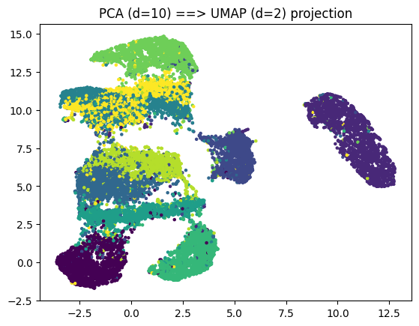
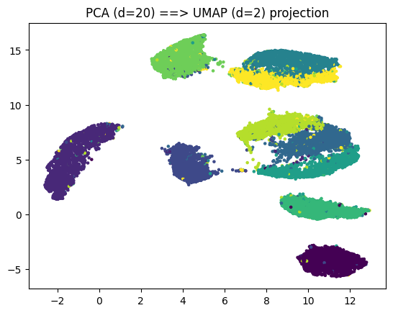
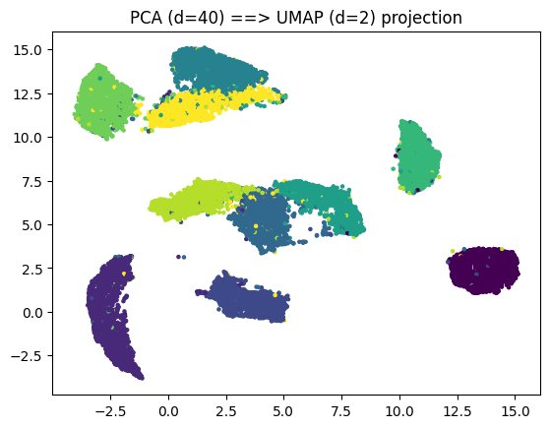
Combining PCA and UMAP

Slide 17
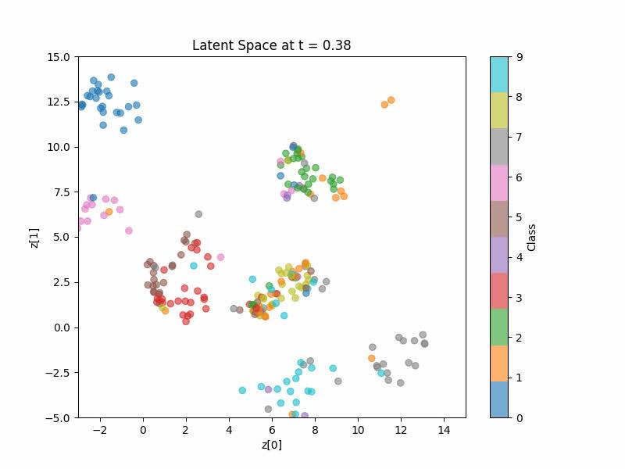
Combining PCA and UMAP

Slide 18
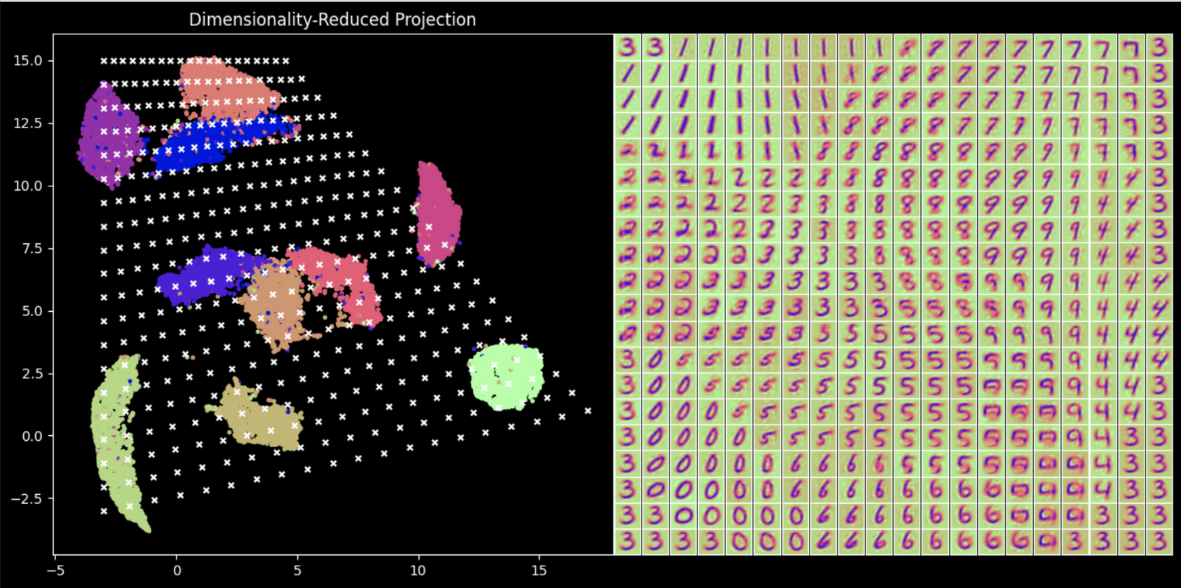
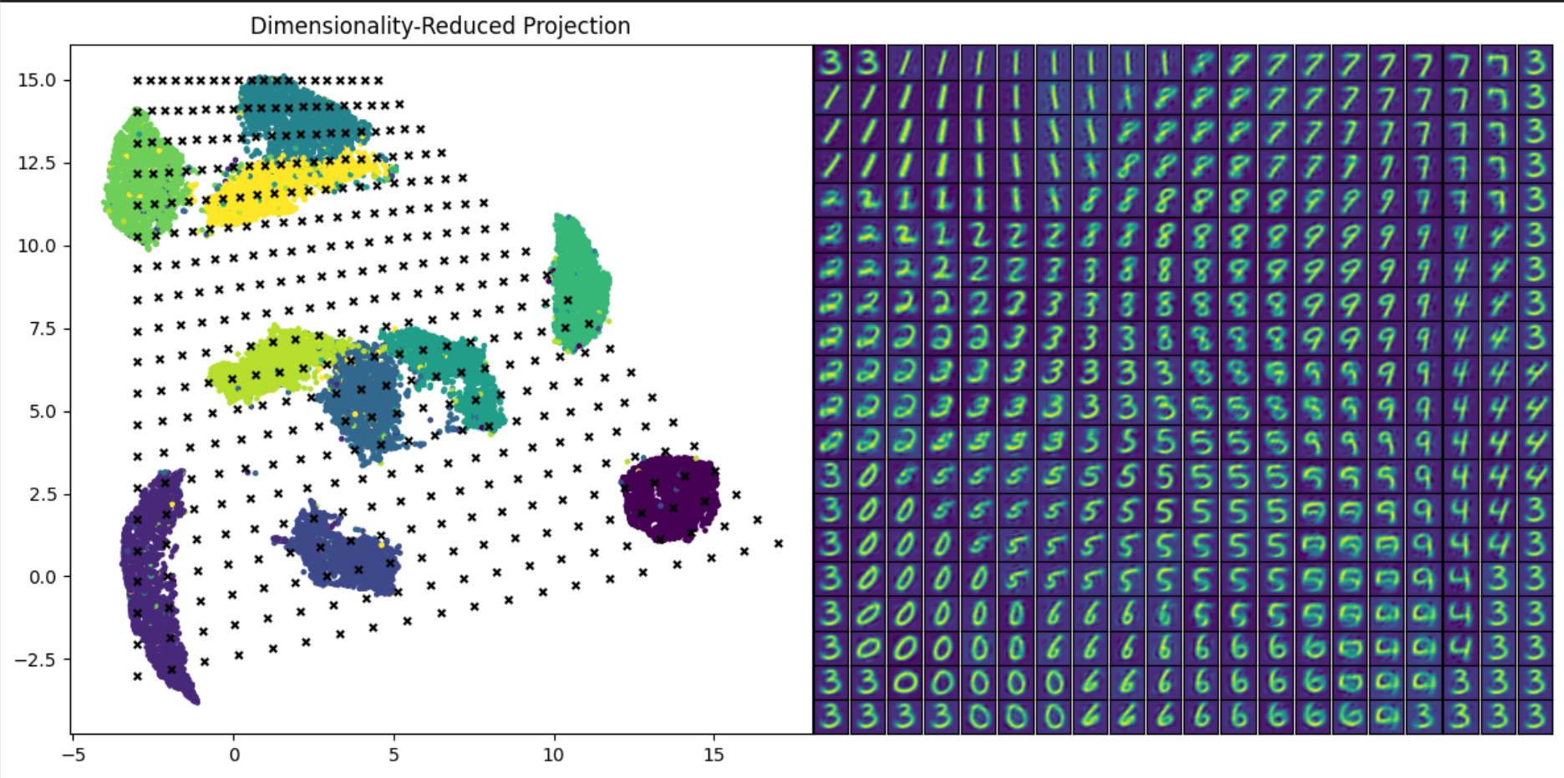
Latent Spaces

Slide 20
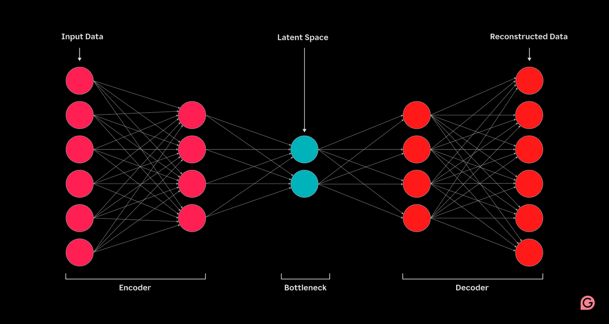
Let’s try Autoencoders!

Slide 21
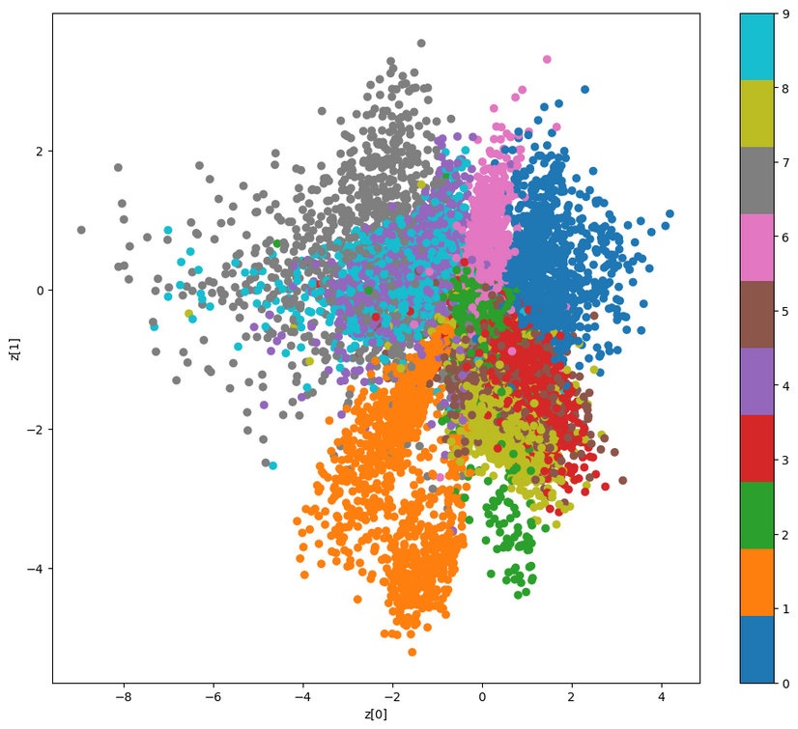
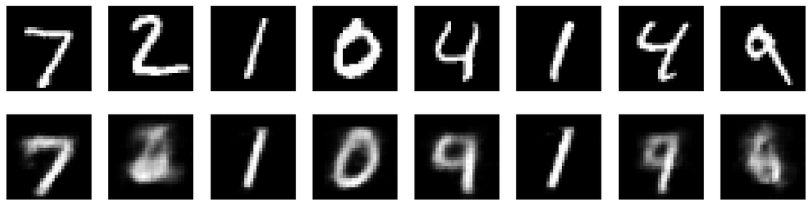
2 Dimensional Autoencoder
Notes:
784 -> 2, why its blurry,
But this allows us to plot everything deterministically
Note the orange, blue, and grey(0, 1, and 7) especially

Slide 22
Now to Apply to FM

Slide 23
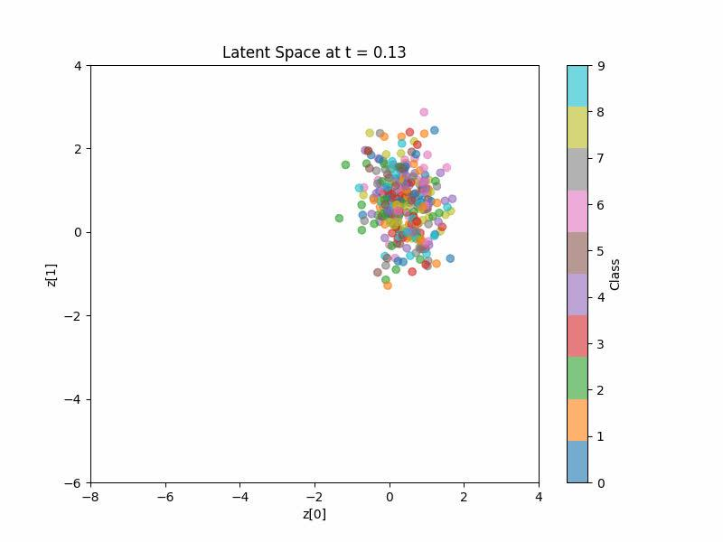

Slide 24

How do we train the model?
(Flow Matching Process)
Notes:
x1 is target image >> what we hope to create
y is class label
x0 is random gaussian in image space
>> flow matching via sample_location_and_conditional_flow >> give start and end iamge >> pick point somewhere in between the two >> we give the model this point in the image and the time >> run model to get velocity >> calculate loss
______________________________
for epoch in range(n_epochs):
for i, data in enumerate(train_loader):
optimizer.zero_grad()
x1 = data[0].to(device)
y = data[1].to(device)
x0 = torch.randn_like(x1)
t, xt, ut = FM.sample_location_and_conditional_flow(x0, x1)
vt = model(t, xt, y)
loss = torch.mean((vt - ut) ** 2)
loss.backward()
optimizer.step()
print(f"\r epoch: {epoch}, steps: {i}, loss: {loss.item():.4}", end="")

Slide 25

At time t
x(1)
Notes:
hayley
we start with a point

Slide 26

At time t
x(1)
x(0)
Notes:
hayley

Slide 27
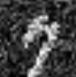
At time t
x(1)
x(t)
(t=0.6)
x(0)

Slide 28
At time t
u(t)
x(1)
x(t)
v(t)
(t=0.6)
x(0)
Notes:
model predicts orange

Slide 29
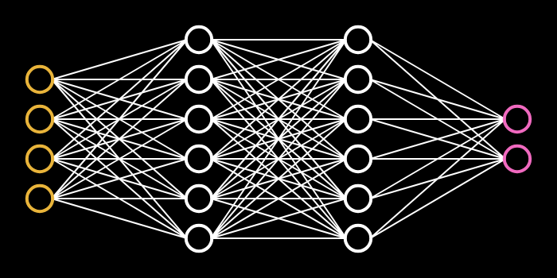
Flow Matching Model
x(t)
v(t)
t
Source: Victor Zhou – Neural Networks from Scratch – victorzhou.com
Notes:
hayley
pretend is unet model

Slide 30
Simplifications we Made
This process is called Exact Optimal Transport FM, there are others
In order to generate all MNIST numbers, we add a class conditioning input as well.
Notes:
- use unet instead neural network
- we use conditional flow matching instead of flow matching
- MNIST include

Slide 31
Conditional Flow Matching Model
y
x(t)
conditional flow mtatching vs non conditional
v(t)
t
Source: Victor Zhou – Neural Networks from Scratch – victorzhou.com
Notes:
we add condition class label so that the model knows what portion of the image space it's learning
- talk about conditional flow matching

Slide 32
Neural ODE
Notes:
vector field slowly move the points
kind of like pushing you in a direction
- flow matching trying to detect the wind
- try to predict ocean currents
- decide what wind where to go to a specifi direction

Slide 33



Conditional vs Marginal
Probability Paths
Conditional Probability Path
Marginal Probability Path
The transformation from a gaussian distribution to a single point
Hasfura, 2025
The distribution that results from first sampling a z from p_data and then sampling from the CPP p_t(x|z).
Hasfura, 2025
Flow Matching
Learn global vector field by aggregating conditional probability paths to match the evolution of the marginal probability distribution over time.
Notes:
Isaac

Slide 34
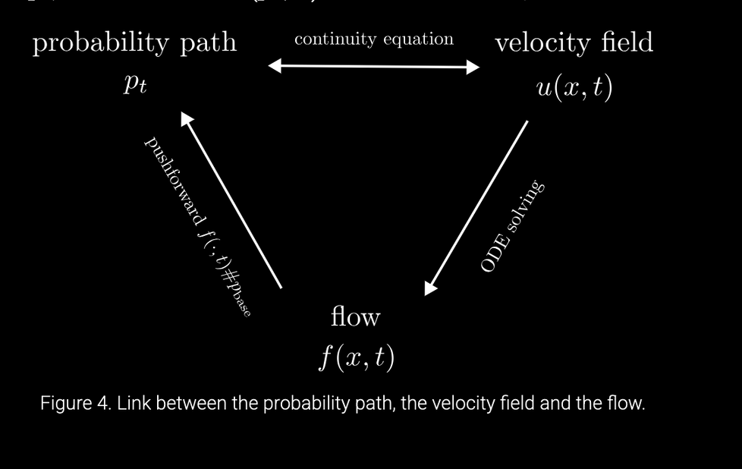
Confusing Terms
Probability Path
Vector/Velocity Field
The entire state of the latent variables’ probability distribution of changes at a point in time.
ie. probability of leaf flowing in a direction
If particles move out of an area, the density there must decrease.
If particles move in, the density increases.
At this moment in time, a particle should move this fast in a specific direction.
ie. how fast we think and what direction we think a leaf will go in a creek
Flow
The actual trajectory of x(t) over.
ie. actual path leaf flows down in creek
Notes:
Isaac

Slide 35
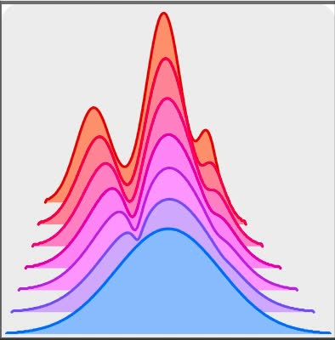
Variational Inference with Normalizing Flows (snapshots over time)
Related Works
Use normalizing flow to change one distribution by modeling density distribution of latent variables and tracking distribution by predicting exact log probability.
Continuous-Time Flows for Efficient Inference and Density Estimation
Replace discrete steps with continuous transformation using ordinary differential equations for more efficient probabilistic model >> exact path to get to next point
Score-Based Generative Modeling through Stochastic Differential Equations
Learn direction that we should denoise with scoring guidance using score function. Think diffusion in continuous time math.
Denoising Diffusion Probabilistic Models
Gradually removing noise from image step by step
Notes:
hayley

Slide 36
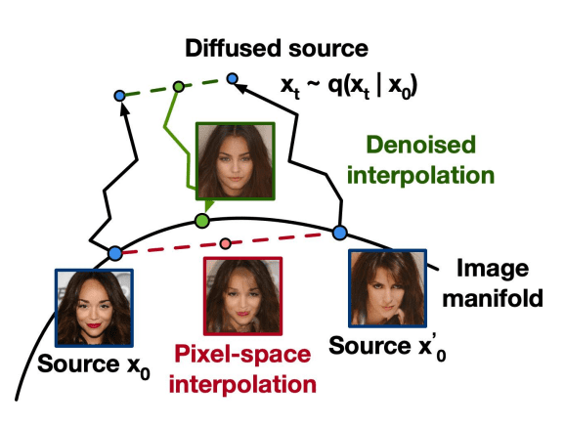
Flow Matching is now SoTA
Stable Diffusion 3.5
Notes:
Isaac

Slide 37
Diffusion Models | Flow Matching
Discrete time or stochastic differential equation-based | Learn vector field through regression
Gradually remove noise step by step | Push starting x0 to goal data distribution
Slow (takes many steps, ie. 1000) | Efficient (via ordinary differential equation solver)
Flow Matching’s Biggest Competitor
Diffusion vs. Flow Matching
Notes:
add that you can write diffusion in the definition of flow matching
flow mathcing encompasses diffusion
Isaac

Slide 38
Key Insights & Retrospective
Unifies with Diffusion Models
No Score Function Needed
Diffusion could be equivalant to flow matching in certain instances.
Fast training and stable. Not prone to mode collapse like GANS and faster than basic diffusion.
Flexible Framework
Flow Matching == Next Big Thing
Can encompass diffusion (learn denoising function), score-based models (diffusion model training on score function), and ODE-models
Fast training and stable. Not prone to mode collapse like GANS and faster than basic diffusion.
Notes:
hayley

Slide 39
Kahoot!

Slide 40


Try it yourself!
https://tinyurl.com/
CSC566-FM-Notebook
https://tinyurl.com/
CSC566-FM-Solution

Slide 41
Flow Matching Q & A
By Dylan, Hayley and Isaac

